Slide 1
User Account in Linux

Slide 2
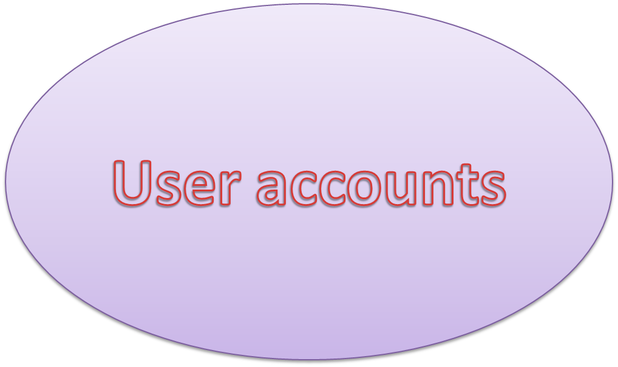

Slide 3
How Linux User Accounts Work
Username
Password
By default, all user home directories are created and maintained in the /home
  directory.
However, the root user’s home directory is /root

Slide 4
Purpose of managing different “User Accounts”
Unix always supported the pool of multiple users working independently and simultaneously on the same computer.
That only authorized users are able to access system. (i.e. username and password)
Each user is assigned a directory, calls home directory ,for sorting the personal data .
Access to resources like file and devices.
e.g.-any authorized user is able to read the “message of the day”

Slide 5
Super users and normal users
Many large systems make a distinction between an SU and NU. Particularly user is prevented from performing sensitive tasks, such as following, unless the user has administrator privileges :
User account management
Periodic backup of data
Global maintantenance and upgrade of the system
Global installation of applications, devices, and their drivers

Slide 6
Why we need to differentiate
SU and NU?
The administrator account in RHL is called root. The power of root is so extensive that almost no task is forbidden for this account. While its impossible for a normal user to delete system files, root is able to delete them all easily.
for this reason, the root account should be used with great care i.e. only by SU.

Slide 7
RHM user and manager
In system when you launch any RHL’s graphical administration tools from a non-root account, Linux will (if necessary)prompt you to enter the password to the root account.

Slide 8
Creating a group
Group are useful when we need to treat a number of different users the same way .for example , if we want to grant a group of users access to a particular file or directory, we add the users to a group and grant the permission to the group (instead of to the individual user accounts).

Slide 9
Creating a User Account
Select Applications (the main menu on the panel) => System Settings => Users & Groups from the panel.
You can also start the User Manager by typing redhat-config-users at a shell prompt.
If you are not logged in as root, you will be prompted for your root password.
The window shown in Figure will appear. Click Add User.

Slide 10
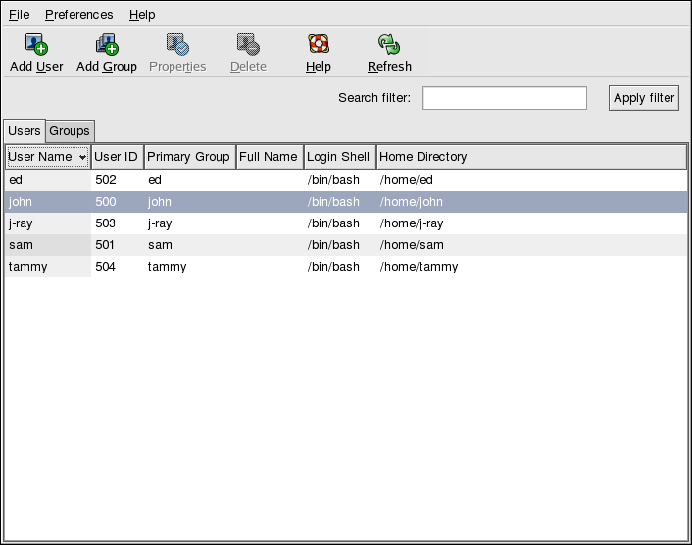

Slide 11
In the Create New User dialog box, enter a username (this can be an abbreviation or nickname), the full name of the user for whom this account is being created, and a password (which you will enter a second time for verification). The name of this user's home directory and the name of the login shell should appear by default. For most users, you can accept the defaults for the other configuration options. Refer to the Red Hat Enterprise Linux System Administration Guide for details about additional options.
Click OK. The new user will appear in the user list, signaling that the user account creation is complete.

Slide 12
CLI
To create a user account from a shell prompt:
Open a shell prompt.
If you are not logged in as root, type the command su - and enter the root password.
Type useradd followed by a space and the username for the new account you are creating at the command line (for example, useradd jsmith). Press [Enter]. Often, usernames are variations on the user's name, such as jsmith for John Smith. User account names can be anything from the user's name, initials, or birthplace to something more creative.
Type passwd followed by a space and the username again (for example, passwd jsmith).
At the New password: prompt enter a password for the new user and press [Enter].
At the Retype new password: prompt, enter the same password to confirm your selection.

Slide 13
Need to Kno…..
1. Username: User login name used to login into system. It should be between 1 to 32 charcters long.
2. Password: User password (or x character) stored in /etc/shadow file in encrypted format.
3. User ID (UID): Every user must have a User ID (UID) User Identification Number. By default UID 0 is reserved for root user and UID’s ranging from 1-99 are reserved for other predefined accounts. Further UID’s ranging from 100-999 are reserved for system accounts and groups.
4. Group ID (GID): The primary Group ID (GID) Group Identification Number stored in /etc/group file.
5. User Info: This field is optional and allow you to define extra information about the user. For example, user full name. This field is filled by ‘finger’ command.
6. Home Directory: The absolute location of user’s home directory.
7. Shell: The absolute location of a user’s shell i.e. /bin/bash.

Slide 14
2. Create a User with Different Home Directory
[root@tecmint ~]# useradd -d /data/projects anusha
You can see the user home directory and other user related information like user id, group id, shell and comments.
[root@tecmint ~]# cat /etc/passwd | grep anusha

Slide 15
3. Create a User with Specific User ID
[root@tecmint ~]# useradd -u 999 navin
Now, let’s verify that the user created with a defined userid (999) using following command.
[root@tecmint ~]# cat /etc/passwd | grep tecmint
navin:x:999:999::/home/navin:/bin/bash

Slide 16
4. Create a User with Specific Group ID
specific UID and GID simultaneously with the help of ‘-u‘ and ‘-g‘ options.
[root@tecmint ~]# useradd -u 1000 -g 500 tarunika
Now, see the assigned user id and group id in ‘/etc/passwd‘ file.
[root@tecmint ~]# cat /etc/passwd | grep tarunika
tarunika:x:1000:500::/home/tarunika:/bin/bash

Slide 17
5. Add a User to Multiple Groups
[root@tecmint ~]# useradd -G admins,webadmin,developers tecmint

Slide 18
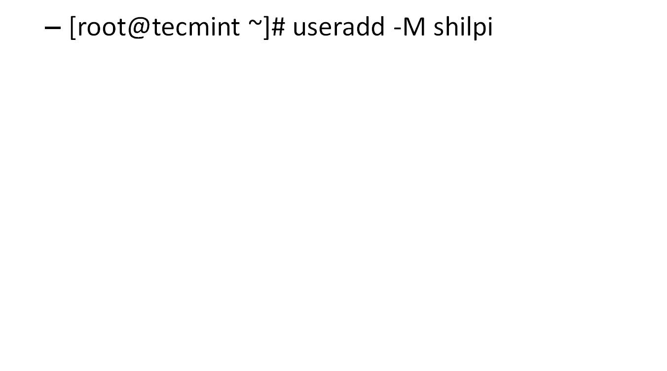
6. Add a User without Home Directory

Slide 19
7. Create a User with Account Expiry Date
[root@tecmint ~]# useradd -e 2014-03-27 aparna

Slide 20
8. Create a User with Password Expiry Date
[root@tecmint ~]# useradd -e 2014-04-27 -f 45 tecmint

Slide 21
9. Add a User with Custom Comments
[root@tecmint ~]# useradd -c "Manis Khurana" mansi

Slide 22
10. Change User Login Shell:
[root@tecmint ~]# useradd -s /sbin/nologin tecmint

Slide 23
Adding group
groupadd [options] group
Remove group
groupdel group

Slide 24
-f, --force
This option causes the command to simply exit with success status if the specified group already exists. When used with
-g, and the specified GID already exists, another (unique) GID is chosen (i.e. -g is turned off). -g, --gid GID The numerical value of the group's ID. This value must be unique, unless the
-o option is used. The value must be non-negative. The default is to use the smallest ID value greater than 999 and greater than every other group. Values between 0 and 999 are typically reserved for system accounts.
-h, --help Display help message and exit.
-K, --key KEY=VALUE Overrides /etc/login.defs defaults (GID_MIN, GID_MAX and others). Multiple -K options can be specified. Example: -K GID_MIN=100 -K GID_MAX=499
Note: -K GID_MIN=10,GID_MAX=499 doesn't work yet.
-o, --non-unique This option permits to add a group with a non-unique GID.
-p, --password PASSWORD The encrypted password, as returned by crypt(3). The default is to disable the password. Note: This option is not recommended because the password (or encrypted password) will be visible by users listing the processes.
You should make sure the password respects the system's password policy.
-r, --system Create a system group. The numeric identifiers of new system groups are choosen in the SYS_GID_MIN-SYS_GID_MAX range, defined in login.defs, instead of GID_MIN-GID_MAX.

Slide 25
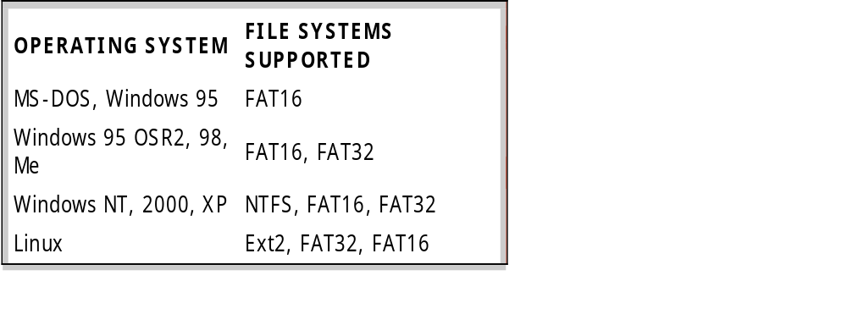
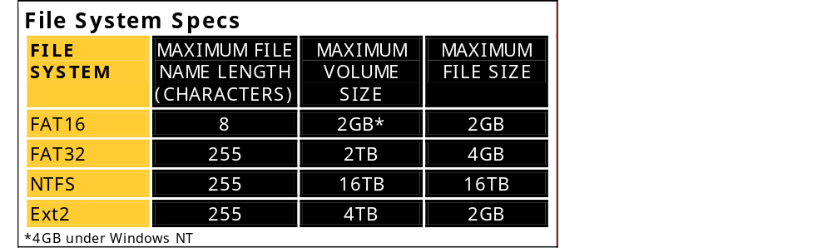
File structure of linux

Slide 26
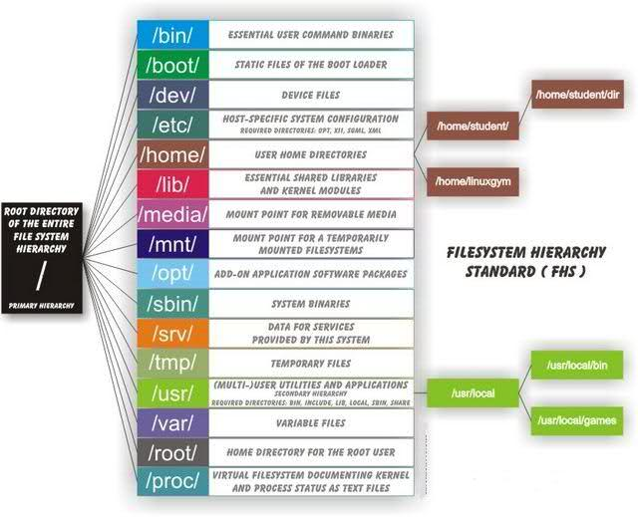

Slide 27
/bin : All the executable binary programs (file) required during booting, repairing, files required to run into single-user-mode, and other important, basic commands viz., cat, du, df, tar, rpm, wc, history, etc.
/boot : Holds important files during boot-up process, including Linux Kernel.
/dev : Contains device files for all the hardware devices on the machine e.g., cdrom, cpu, etc
/etc : Contains Application’s configuration files, startup, shutdown, start, stop script for every individual program.
/home : Home directory of the users. Every time a new user is created, a directory in the name of user is created within home directory which contains other directories like Desktop, Downloads, Documents, etc.
/lib : The Lib directory contains kernel modules and shared library images required to boot the system and run commands in root file system.
/lost+found : This Directory is installed during installation of Linux, useful for recovering files which may be broken due to unexpected shut-down.
/media : Temporary mount directory is created for removable devices viz., media/cdrom.
/mnt : Temporary mount directory for mounting file system.
/opt : Optional is abbreviated as opt. Contains third party application software. Viz., Java, etc.

Slide 28
GNOME
GNOME is an acronym for GNU Network Object Model Environment. Its target operating system is Linux.
GNU-The most important part of an operating system is the kernel. In a GNU/Linux system, Linux is the kernel component. The rest of the system consists of other programs, many of which were written by or for the GNU Project.st derivatives of BSD.

